Slide 1

IT Project Management Principles
Justin Wasser
6/27/2023
ITEC 640
UMGC
Notes:
Hello, I’d like to start off by thanking the Sr. executives at Walmart for having me here today. My name is Justin Wasser, today’s date is June, 27th 2023 and I have been asked to present my findings on how various individual IT Project Management topics relate to a project’s overall success.

Slide 2
Presentation Schedule
Summary of findings
My recommendations
Specifics about each topic
Conclusion
Notes:
I will start this presentation by presenting a summary of my findings, my recommendations, and then I will go into specifics about each topic and present my conclusion.

Slide 3
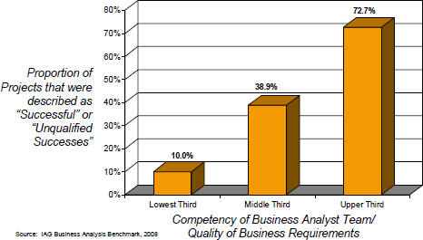
Summary of Findings
(Krigsman, 2009)
Notes:
For starters, this topic is worth exploring as your organization will improve its overall profitability if it can improve its IT project success rates.
To that point, “A survey published in HBR found that the average IT project overran its budget by 27%. Moreover, at least one in six IT projects” (Andriole, 2020) has “a cost overrun of 200%” (Andriole, 2020)
IT projects differ from other projects due to the unstructured nature of technology. Therefore, a skilled project manager is crucial to success. Additionally, full project Integration is essential to keep all components of an IT project working in harmony. Moreover, using sound methodologies for selecting a project, identifying its scope, and planning a project’s implementation all improve its odds of success.
Most of the causes of project failures trace back to the emphasis or lack thereof, that a company places on the discipline of project management (Krigsman, 2009).
The following graph illustrates the relationship between the competency of the project team and project success rates (Krigsman, 2009).
A project team of above-average ability is almost twice as likely to achieve project success as a project team of average skill, while a lesser-skilled project team has only a 10% chance of achieving project success (Krigsman, 2009).
The data dictates that you recalibrate your cost/benefit analysis of IT projects to incorporate the fact that you are nearly twice as likely to achieve project success by employing a skilled project management team compared to a project management team of average ability. Moreover, a skilled project management team is more than 7 times as likely to succeed compared to a project management team of below-average ability (Krigsman, 2009).

Slide 4
Topics
IT Project Management
Project Management Skills & Leadership
Project Integration Management
Project Selection, Initiation, and Requirement
Project Scheduling
Notes:
Specific IT project management topics analyzed include:

Slide 5
IT Project Management
How does IT Project Management differ from other types of project management?
Answer:
IT Projects are more flexible in their scope and therefore they require an even greater level of management skill to successfully complete compared to non-IT projects (Nance & Howard, n.d.-a).
Notes:
How does IT Project Management differ from other types of project management?
Answer:
IT Projects are more flexible in their scope and therefore they require an even greater level of management skill to successfully complete compared to non-IT projects (Nance & Howard, n.d.-a).

Slide 6
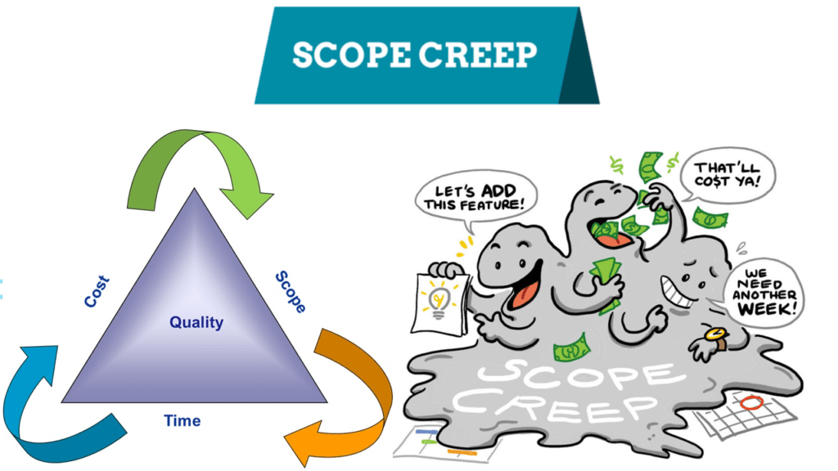
IT Project Management’s Challenge
Scope creep refers to changes in project deliverables after the requirements analysis phase, without accounting for the changes’ effect on project cost and timeline (Project Management Institute, 2021; Olson, 2014).
Managing scope creep is essential to complete IT projects on time and within budget.
(Tech Agilist, 2020)
Notes:
Scope creep refers to changes in project deliverables after the requirements analysis phase, without accounting for the changes’ effect on project cost and timeline (Project Management Institute, 2021; Olson, 2014).
Managing scope creep is essential to complete IT projects on time and within budget. However, as just mentioned, this is especially difficult to achieve due to the fluid nature of technology (Nance & Howard, n.d.-a).

Slide 7
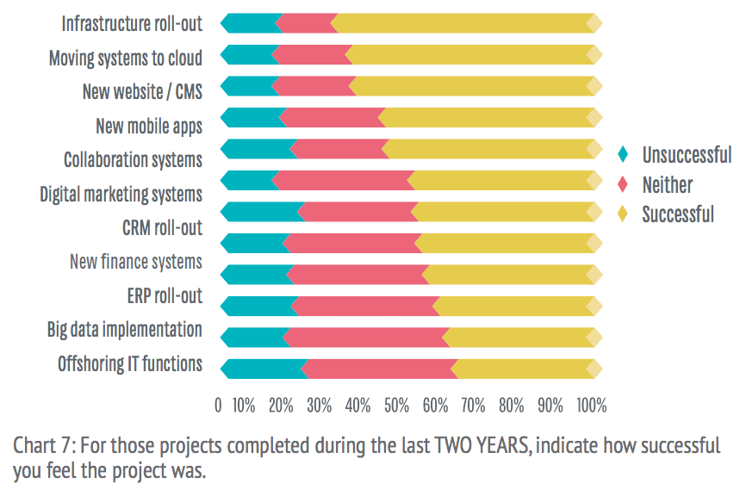
IT project management – failure rates
“Only 40% of projects at IBM meet the company's three key goals – schedule, budget, and quality.” (Andriole, 2020).
Additional research into IT project failure rate found that “success in 68 percent of technology projects is "improbable"” (Krigsman, 2009).
(Chaffey, 2016)
Notes:
The term ‘project failure’ is a complex phrase as a project’s relative failure is measured in degrees (Olson, 2014). Moreover, IT projects vary widely both in size and complexity, both of which have a proportionate effect on project failure rates, as illustrated in this chart (Chaffey, 2016). Having said that…
“Only 40% of projects at IBM meet the company's three key goals – schedule, budget, and quality.” (Andriole, 2020).
Other research into IT project failure rate found that “success in 68 percent of technology projects is "improbable"” (Krigsman, 2009).

Slide 8


Project Management Skills & Leadership
An effective IT Project Manager must be versatile, as a variety of skills is needed to accomplish their mission.
(REI, n.d.; Vinsys, 2020)
Notes:
There is no one-size fits all model for an effective project manager, however, there are a few key skills all project managers need to be successful. First, an effective project manager must be a skilled communicator, capable of clearly relaying information to both project team members and executives like yourselves alike (Nance & Howard, n.d.-b). Moreover, an effective project manager must also be a masterful problem-solver, able to negotiate and resolve conflicts as they inevitably arise while keeping a project on track (Nance & Howard, n.d.-b). Finally, an effective project manager must also be a respected leader, able to motivate the project team to accomplish the project as designed, within budget, and on time through positive reinforcement ideally (Nance & Howard, n.d.-b).

Slide 9
Project Management Skills & Leadership
Essential skills an IT project manager must possess:
Communication
Leadership
Problem-solving
Conflict resolution
Financial
Planning
Technical
(Nance & Howard, n.d.-b; Olson, 2014)
(REI, n.d.; Vinsys, 2020)
Notes:
Besides interpersonal skills, an effective project manager must also possess a baseline of financial, and project planning knowledge in addition to the specific technical knowledge needed to manage a given IT project (Nance & Howard, n.d.-b; Olson, 2014).

Slide 10

Project Integration Management
Project integration management describes all processes necessary to keep separate teams working towards the same goals (Roseke, 2017).
Project integration management activities occur throughout a project’s management lifecycle (Roseke, 2017).
(monday.com, 2023)
Notes:
Project integration management describes all processes necessary to keep component teams, especially technical and people-focused, aligned and working towards the same goals (Prosci, n.d.; Roseke, 2017)
Project integration management activities occur throughout a project’s management lifecycle (Roseke, 2017).

Slide 11
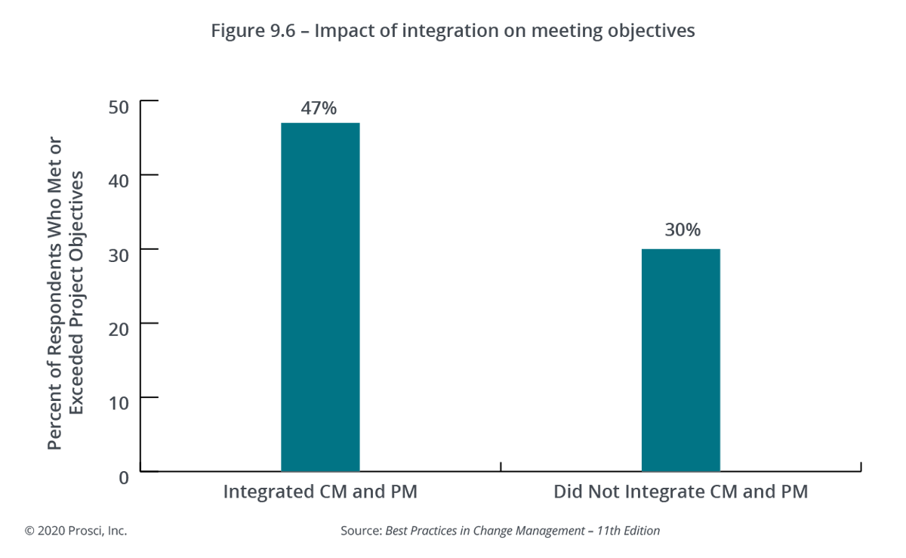
Project Integration Management Processes
Create project charter
Create project management plan
Coordinate and supervise work
Track & control work progress
Integrated change control
Close project
(Marion, 2018; Roseke, 2017)
(Prosci, n.d.)
Notes:
Project Integration Management Processes include the
Creation of the project charter, which is the formal authorization to begin a project (Marion, 2018).
Creation of the project management plan, which defines the project scope, the estimated time-to-completion, and the projected cost (Marion, 2018).
Coordinating and supervising work
Tracking & control work progress to ensure that specifications and deadlines are being met (Marion, 2018).
Integrated change control, meaning if any changes wish to be proposed, the “change control system” (Nance & Howard, n.d.) should be utilized to formally request that a feature be added to the project deliverables (Nance & Howard, n.d.). Furthermore, “integrated change control” (Olson, 2014) is used to ensure approved changes are communicated and integrated into the overall project management plan, the plan’s subprocesses, its estimated time-to-completion, and its projected cost (Olson, 2014). Lastly, all approved changes should be documented as educational materials to help improve future project management activities (Nance & Howard, n.d.-c).
To that point, the graph presented depicts a 17% increase in exceeding project objectives when change management and project management are integrated (Prosci, n.d.).
Lastly, a project is deemed successful and may be closed when the client accepts “the deliverables and agree(s) that they are complete” (Marion, 2018).

Slide 12

Project Selection
Project Selection Criteria
Management Support
Project Timing
Business Case
Practicality
Opportunity Cost
(Selection of Projects, n.d.)
(Newman, n.d.)
Notes:
A number of factors need to be considered when evaluating potential IT projects.
The most crucial of which is whether the project will be supported and therefore financed by management (Selection of Projects, n.d.).
Next, the timing of the project must be evaluated, to understand if it is the appropriate time for the organization to undertake the project, as well as if key personnel have sufficient time to devote to the project (Selection of Projects, n.d.).
The business case for a project must also be considered during the project selection phase, examples of which include improving profitability, efficiency, enhancing organizational strategy, or strengthening relationships with partners, to name a few (Selection of Projects, n.d.).
The practicality of the proposed project must also be considered, this requires assessing the organizational capacity to pursue a given project (Selection of Projects, n.d.).
Lastly, an assessment of the cost and benefit of the proposed project must be weighed against all other endeavors the organization could pursue with the resources devoted to the project (Selection of Projects, n.d.).

Slide 13

Project Initiation
The project initiation phase begins with “the assignment of the project manager” (Saylor.org, n.d.).
The “Project initiation ends with either the decision not to pursue the project or the creation of a project charter” (Nance & Howard, n.d.-d).
(Soto, n.d.)
Notes:
Once a project has been selected, the initiation phase begins (Saylor.org, n.d.).
The project initiation phase begins with “the assignment of the project manager” (Saylor.org, n.d.) and involves “meetings, identifying the project team, developing the resources needed to develop the project plan, and identifying and acquiring the project management infrastructure” (Saylor.org, n.d.).
“Project initiation ends with either the decision not to pursue the project or the creation of a project charter.” (Nance & Howard, n.d.-d)
Lastly, a project charter is a formal document from management that recognizes the project’s existence, details the project’s business case and its deliverables, and empowers the project manager to start working on project tasks (Nance & Howard, n.d.-d).

Slide 14

Project Requirement
A project’s requirements, or its scope, identify the responsibilities of a project and where those responsibilities end (Nance & Howard, n.d.-d).
These responsibilities are then broken down into their sub-processes using a work breakdown structure (Nance & Howard, n.d.-d).
(Lucid Content Team, n.d.)
Notes:
A project’s requirements, or its scope, identify the responsibilities of a project and where those responsibilities end (Nance & Howard, n.d.-d).
These responsibilities are then broken down into separate tasks and sub-processes using a work breakdown structure to provide additional project scope clarity (Nance & Howard, n.d.-d).
Having a clearly defined project scope is essential to completing a project on time and within budget, by preventing scope creep (Nance & Howard, n.d.-d).
For IT projects, requirements may include “acceptance tests” (Nance & Howard, n.d.-d), or specifications the end product must meet to be deemed as completed by the project sponsor (Nance & Howard, n.d.-d).
A project’s “scope statement” (Nance & Howard, n.d.-d) will be recorded in a formal document (Nance & Howard, n.d.-d).

Slide 15
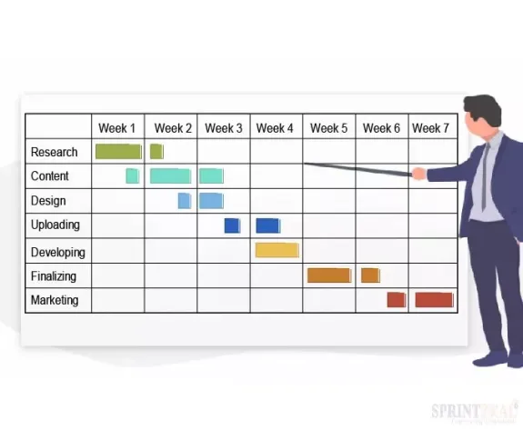
Project Scheduling
Project scheduling requires identifying the degree of dependencies between activities and tasks (Nance & Howard, n.d.-e).
Different types of “scheduling charts” (Nance & Howard, n.d.-e) may be employed to help visualize and track the progress of a project including Gantt charts (Nance & Howard, n.d.-e).
Scheduling tools help identify important information such as the “critical path” (Nance & Howard, n.d.-e).
(Sushmith, 2022)
Notes:
Effective project scheduling relies on an accurate scope statement and detailed work breakdown structure and then breaks individual tasks contained within the work breakdown structure into its component activities, or “specific actions that must be performed” (Nance & Howard, n.d.-e) to create a given process (Nance & Howard, n.d.-d; Nance & Howard, n.d.-e).
An important part of creating a viable project schedule is determining the optimal sequence of activities within individual tasks and for all tasks within the work breakdown structure (Nance & Howard, n.d.-e).
Part of that determination requires identifying the degree of dependencies between activities and between tasks (Nance & Howard, n.d.-e).
Different types of “scheduling charts” (Nance & Howard, n.d.-e) may be employed to help visualize and track the progress of a project including Gantt charts, flow charts, Network charts, PERT charts, and milestone charts (Nance & Howard, n.d.-e).
Lastly, these scheduling tools help identify important information such as the “critical path” (Nance & Howard, n.d.-e) or the quickest possible project completion estimate and whether certain activities/tasks have extra time, or slack where a delay up to a certain point would not affect the overall project timeline (Nance & Howard, n.d.-e).

Slide 16
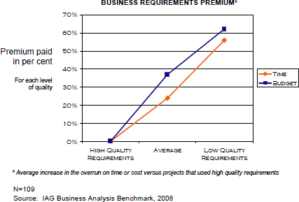
Conclusion
Investing in a highly-skilled project manager and team saves you time and money in the long run (Krigsman, 2009).
(Krigsman, 2009)
Notes:
In conclusion, based on the research conducted for this presentation, it is my recommendation that this organization only hire exceptionally-skilled project managers and analysts, so that high-quality project requirements and processes may be produced (Krigsman, 2009). Adopting this practice will significantly reduce the occurrence and severity of IT project cost overruns, which in turn will improve your organization’s profitability. Thank you.

Slide 17
References
Andriole, S. (2020, December 1). Why No One Can Manage Projects, Especially Technology Projects. Forbes. https://www.forbes.com/sites/steveandriole/2020/12/01/why-no-one-can-manage-projects-especially-technology- projects/?sh=4e53e9af2da2
Chaffey, D. (2016, October 5). What percentage of IT projects fail? [#ChartOfTheDay]. Smart Insights. https://www.smartinsights.com/managing-digital-marketing/web-project-management/percentage-projects-fail- chartoftheday/
Krigsman, M. (2009, January 13). Study: 68 percent of IT projects fail. ZDNet; ZDNet. https://www.zdnet.com/article/study- 68-percent-of-it-projects-fail/
Lucid Content Team. (n.d.). What Is Scope in Project Management? | Lucidchart Blog. Www.lucidchart.com. Retrieved June 25, 2023, from https://www.lucidchart.com/blog/what-is-scope-in-project-management

Slide 18
References
Marion, J. (2018). Project Management : A Common Sense Guide to the PMBOK, Part One-Framework and Schedule. Umgc.edu. https://eds-s- ebscohost- com.ezproxy.umgc.edu/eds/ebookviewer/ebook/bmxlYmtfXzE3MDMyNTFfX0FO0?sid=0944a961-4fcf-4d8c-9f7f- 367c69d737a9%40redis&vid=0&format=EB&rid=1
monday.com. (2023, January 1). What is project integration management in 2022? Monday.com Blog. https://monday.com/blog/remote-work/project-integration-management/
Nance , K., & Howard, C. (n.d.-a). Lesson 1 -Week 1_updated. UMGC. Retrieved June 21, 2023, from https://learn.umgc.edu/d2l/le/content/769734/viewContent/30764358/View
Nance , K., & Howard, C. (n.d.-b). Lesson 2. UMGC. Retrieved June 21, 2023, from https://learn.umgc.edu/d2l/le/content/769734/viewContent/30764316/View

Slide 19
References
Nance , K., & Howard, C. (n.d.-c). Lesson 3 - Project Integration Management. UMGC. Retrieved June 23, 2023, from https://learn.umgc.edu/d2l/le/content/769734/viewContent/30764319/View
Nance , K., & Howard, C. (n.d.-d). Lesson 4 - Requirements Management. UMGC. Retrieved June 25, 2023, from https://learn.umgc.edu/d2l/le/content/769734/viewContent/30764319/View
Nance , K., & Howard, C. (n.d.-e). Lesson 5 - Time Management. UMGC. Retrieved June 25, 2023, from https://learn.umgc.edu/d2l/le/content/769734/viewContent/30764319/View
Newman, R. (n.d.). Project Selection Methods: How to Choose the Right Project? Master of Project Academy Blog; blog.masterofproject.com. Retrieved June 25, 2023, from https://blog.masterofproject.com/project-selection-methods/

Slide 20
References
Olson, D. (2014). Information Systems Project Management (T. Kloppenborg, Ed.). Umgc.edu. http://ezproxy.umgc.edu/login?url=https://search.ebscohost.com/login.aspx?direct=true&db=nlebk&AN=932347&site =eds-live&scope=site&profile=edsebook&ebv=EB&ppid=pp_Cover
Project Management Institute. (2021). A Guide to the Project Management Body of Knowledge (PMBOK® Guide) – Seventh Edition and The Standard for Project Management (ENGLISH): Vol. Seventh edition. Project Management Institute.
Prosci. (n.d.). Integrating Change Management and Project Management. Prosci.com. Retrieved June 23, 2023, from https://www.prosci.com/resources/articles/integrating-change-management-and-project-management

Slide 21
References
REI. (n.d.). Swiss Army Huntsman Knife. Rei.com. Retrieved June 21, 2023, from https://www.rei.com/product/403014/swiss-army-huntsman- knife?sku=4030140000&CAWELAID=120217890003760177&CAGPSPN=pla&CAAGID=112374926328&CATCI=pla- 945494567212&cm_mmc=PLA_Google%7C21700000001700551_4030140000%7C92700056586149289%7CNB%7C717000000666919 16&gclid=C jwKCAjwv8qkBhAnEiwAkY- aho435GcoUY8xfouKlm3lNGrKU6eTl06P1U8FBOekdu62yuv1iBe7eRoCZIYQAvD_BwE&gclsrc=aw.ds
Roseke, B. (2017, January 31). Project Integration Management According to the PMBOK. Www.projectengineer.net. https://www.projectengineer.net/project-integration-management-according-to-the-pmbok/#comments
Saylor.org (n.d.) Chapter 4: Understanding and Meeting Client Expectations in Project Management - From Simple to Complex. pages 103-125 Retrieved from: http://www.saylor.org/site/textbooks/Project%20Management%20-%20From%20Simple%20to%20Complex.pdf.

Slide 22
References
Selection of Projects. (n.d.). W3computing. Retrieved June 25, 2023, from https://www.w3computing.com/systemsanalysis/selection-projects/
Soto, C. (n.d.). Project Initiation | The Ultimate Checklist for Initiating Process Group. Master of Project Academy Blog; blog.masterofproject.com. Retrieved June 25, 2023, from https://blog.masterofproject.com/project-initiation/
Sushmith. (2022, September 15). Gantt chart - A Complete Beginner’s Guide. Sprintzeal.com. https://www.sprintzeal.com/blog/gantt-charts

Slide 23
References
Tech Agilist. (2020, September 22). Agile Scope Creep with Examples. Tech Agilist. https://www.techagilist.com/agile/scrum/agile-scope-creep-with-examples/
Vinsys. (2020, March 7). Roles and Responsibilities of a Project Manager. Vinsys. https://www.vinsys.com/blog/what-are- the-important-roles-and-responsibilities-of-a-project-manager/

